Slide 1
QA HIGHER EDUCATION
QA Centres
Embedded Pathways
Branch Campus
Main Campus Recruitment
Online Pre-Sessional English
100+
17,000+
Students studying with us and our partners
Courses taught in high-demand skill subjects
MANCHESTER
LONDON
100+
7
Countries represented across student body
University partners and affiliates

Slide 2
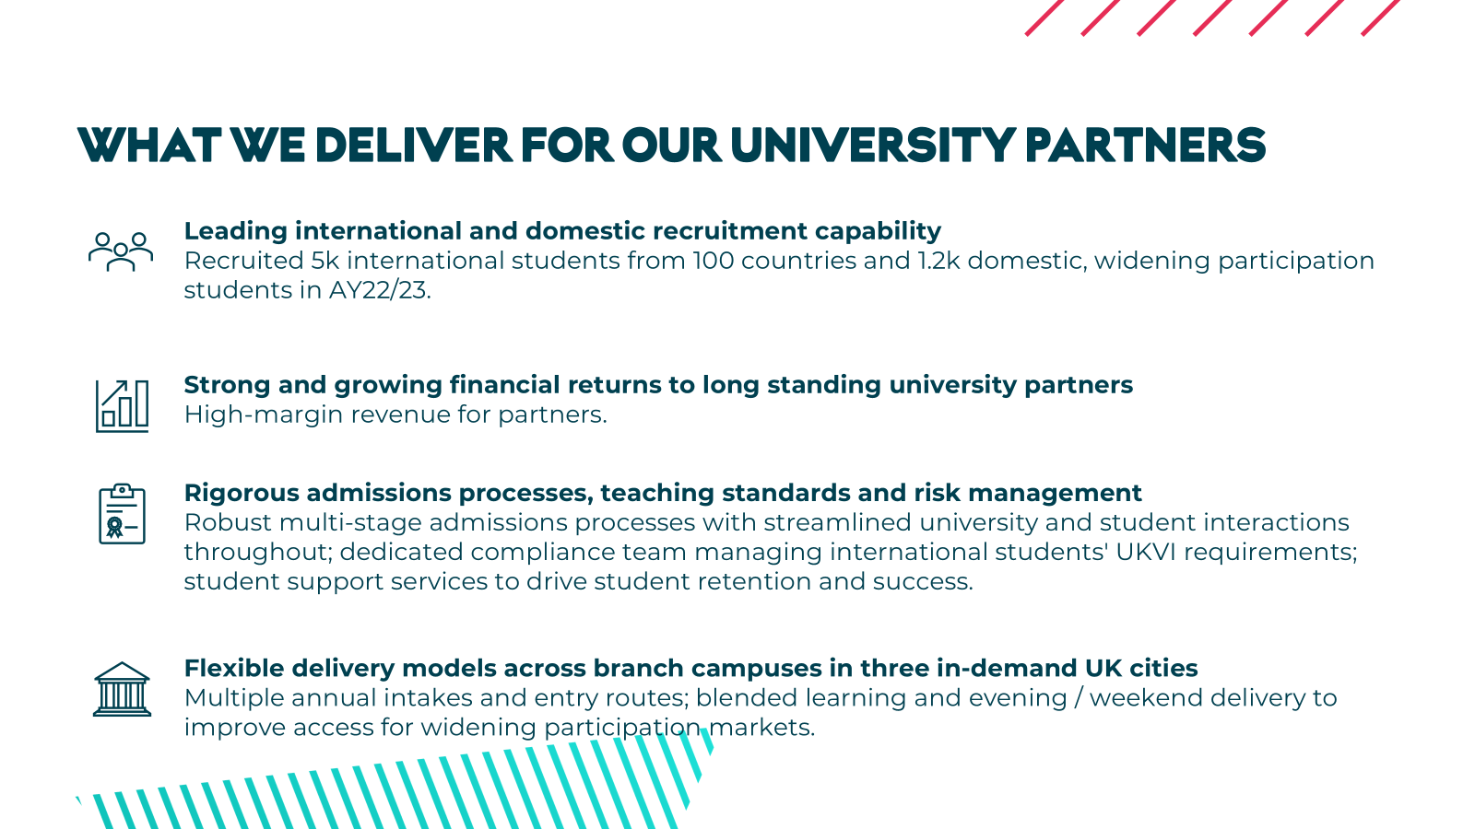

Slide 5
